Slide 2
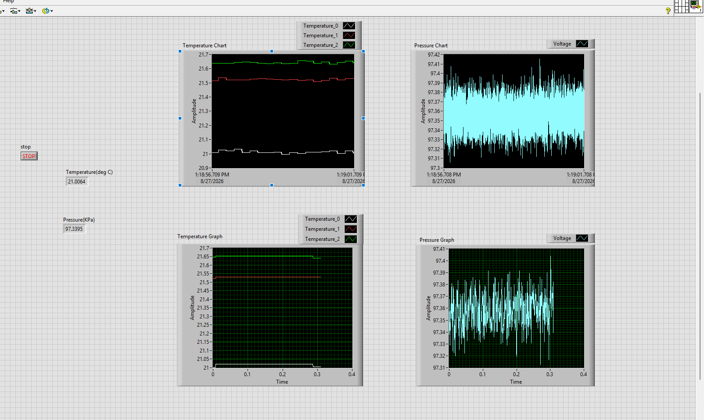
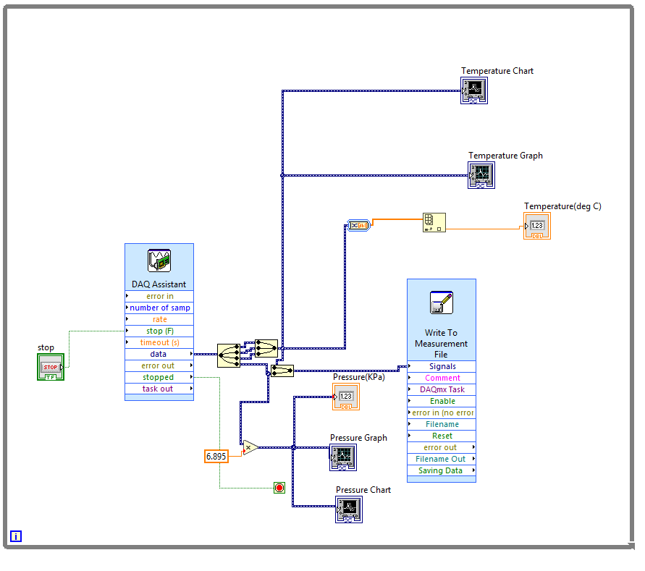
LABVIEW operational views
Front Panel
Block Diagram

Slide 3
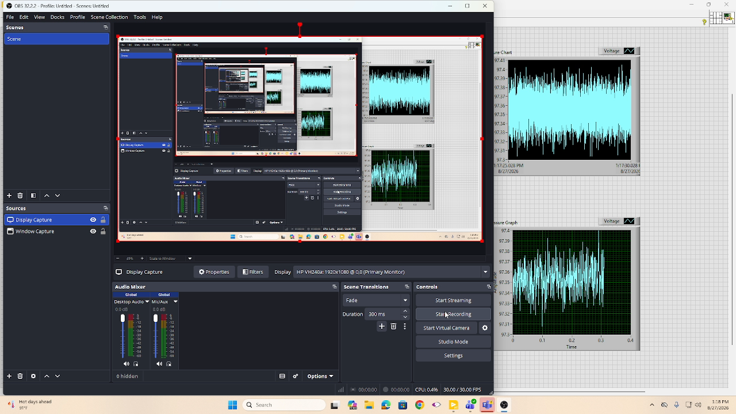
Visual Observations

Slide 4
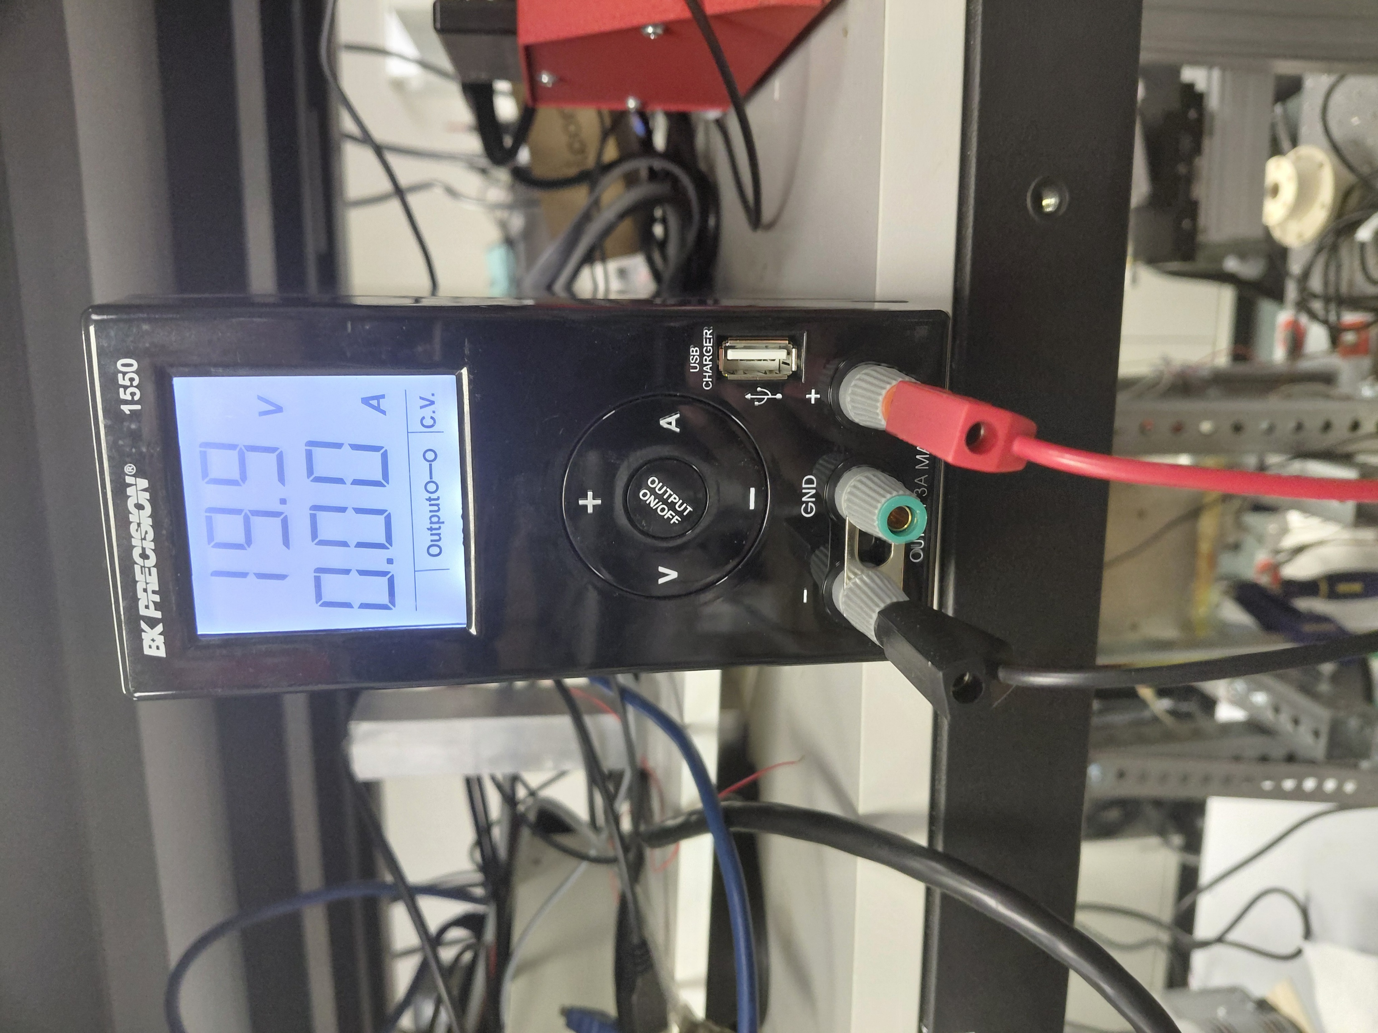
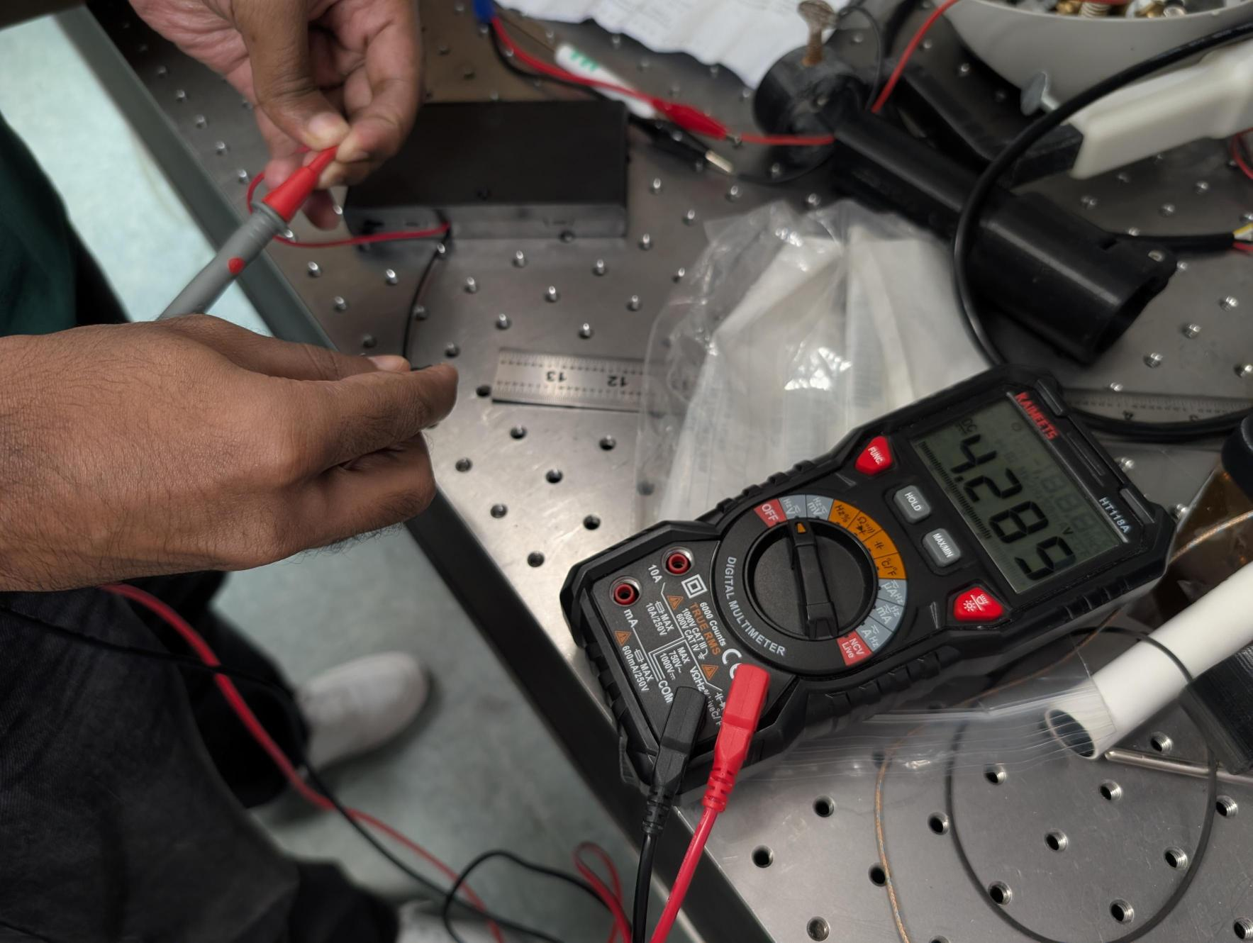
Pressure Measurement
For pressure measurement, we need to excite the sensor with an external source (Battery) or a power supply. Before connecting a power source, check the operating voltage in the manual and whether the battery can supply the required voltage or not.
Power supply
Battery (DC power)

Slide 5
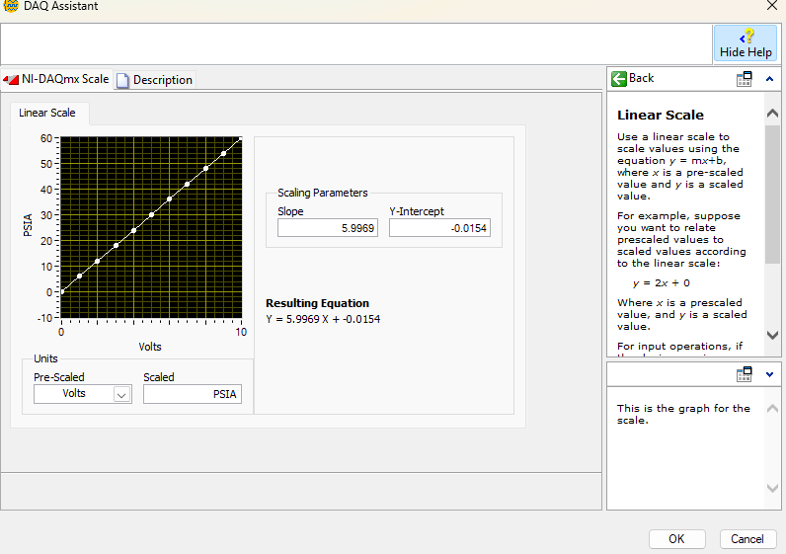
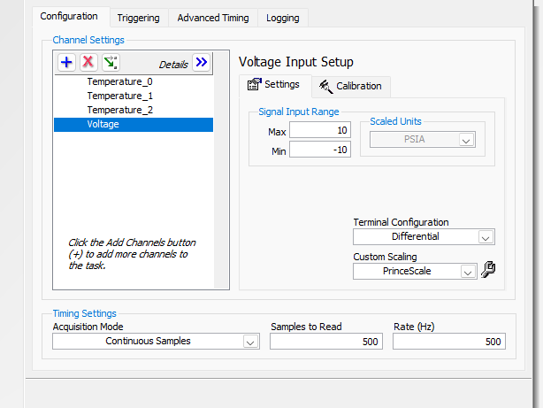
Pressure Calibration
For a pressure transducer that outputs voltage, calibration is required to establish the voltage-to-pressure relationship. Before calibration, plot the measured voltage against the known pressure values to determine the nature of the relationship (linear, polynomial, etc.).

Slide 6
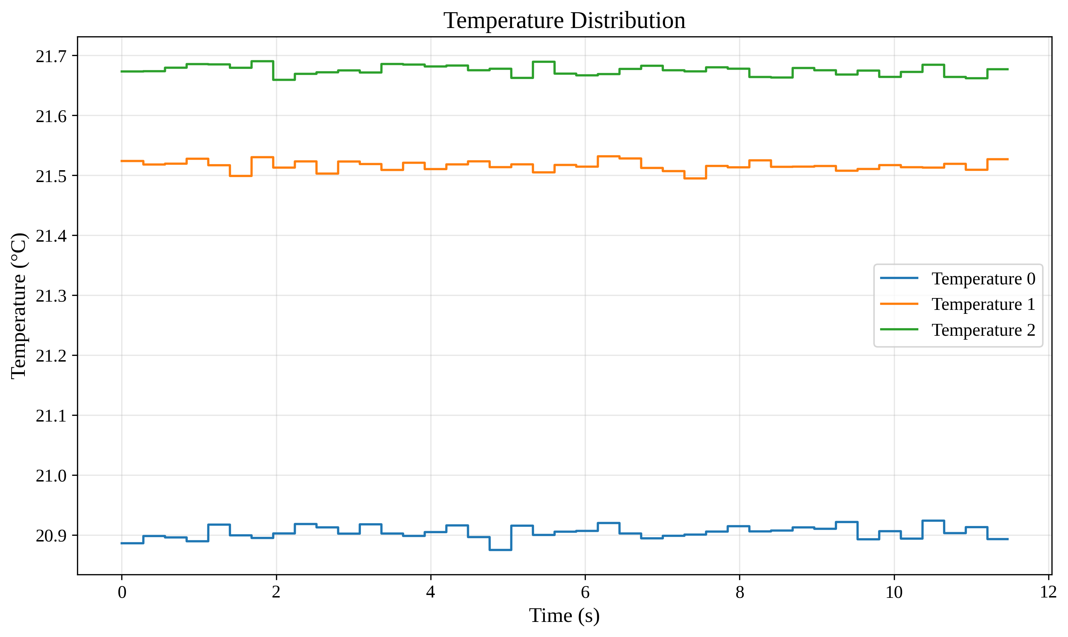
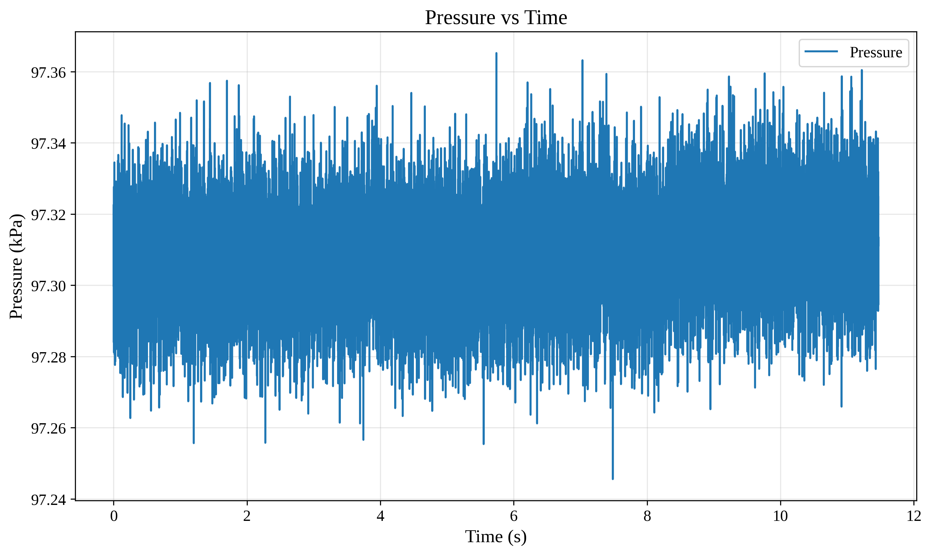
Graphical Analysis

